Slide 1
Oscar analysis
4ST626 - Exploratory Data Analysis

Slide 2
Table of contents
01
02
03
04
05
Data introduction
Data manipulation
Dataset Movies
Dataset Oscars
Final
Summary

Slide 3
About the data
Dataset: Movies
- 7 668 rows, 15 columns
- movie characteristics
- name, rating, genre, year, budget...
Dataset: Oscars
- 9 964 rows, 6 columns
- data about oscar nominations and winners
- year, award, name, movie, winner...
01

Slide 4
Data filtering
Dataset: Movies
- Listwise deletion of missing values from columns: released country, released day of week, writer, rating, star, country, company
Dataset: Oscars
- Movies after 1980 (incl.)
- Column „Award“ does not contain words:
- Award,
- Memorial, or
- Medal
02

Slide 5
Missing values
Dataset: Movies
- Empty strings across various columns -> NA
- Missing continuous values -> Median
- Inconsistent date (February 2018, 1997...)
Dataset: Oscars
- Nominees (NA -> 0)
- Film (““ -> removed)
02

Slide 6
Movie join
Name (Movie name)
Year (Release year).
Datasets were joined using columns
and
2 008 movies were joined together.
02

Slide 7
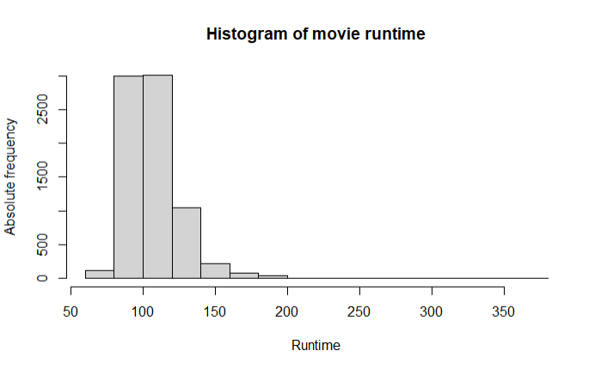
Movie runtime histogram
03

Slide 8
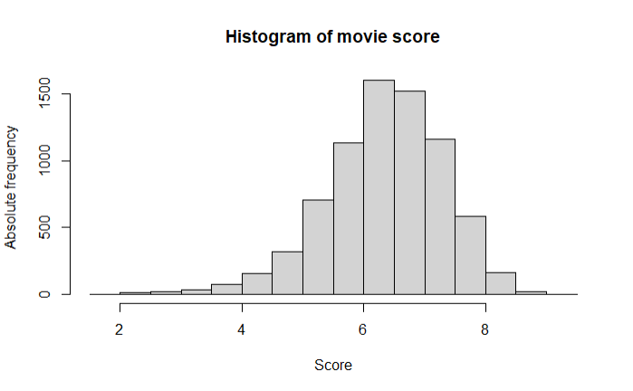
Movie score histogram
03

Slide 9
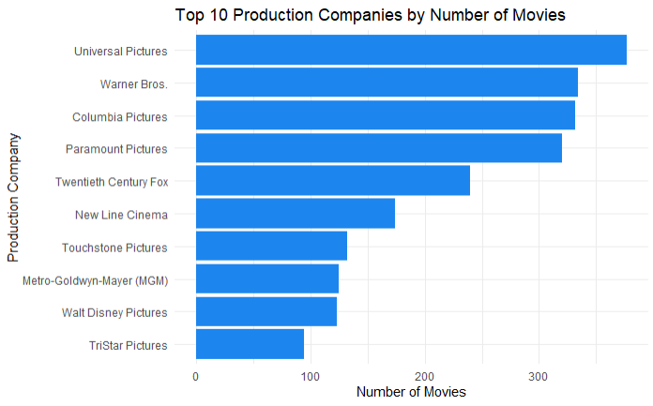
Production companies in movies
03

Slide 10
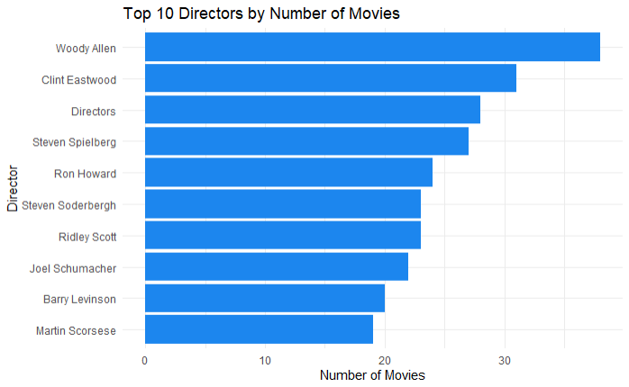
Directors in movies
03

Slide 11
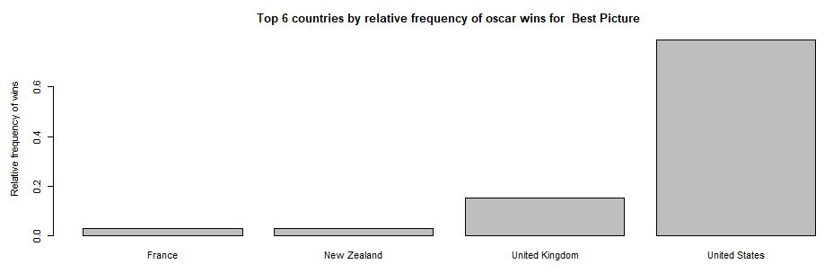
Best picture by country
Winrate: 20,1 %
Winrate: 41 %
04

Slide 12
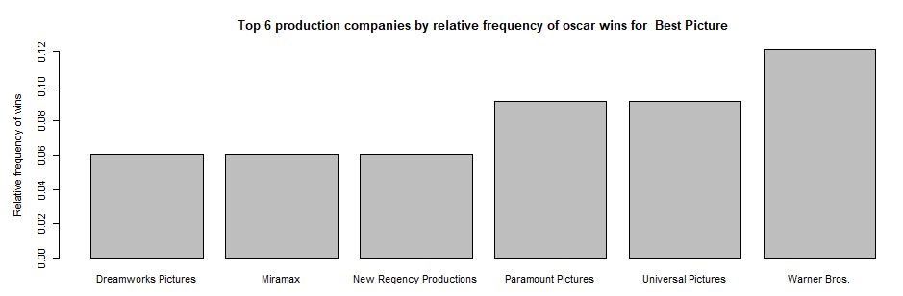
Best picture by company
Inception, The Matrix, American Sniper
04

Slide 13
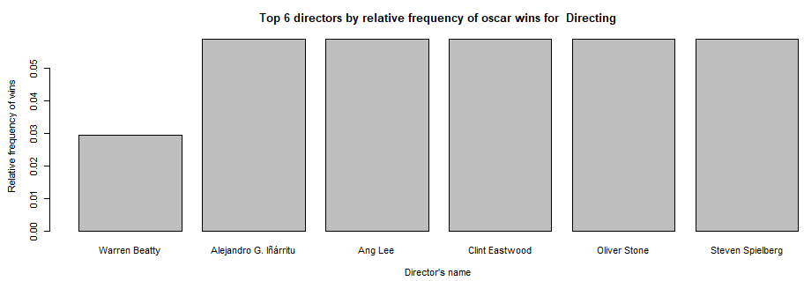

Directing by directors
04

Slide 14
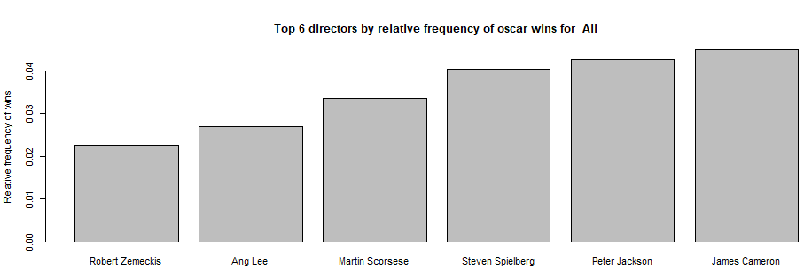


All categories by directors
04

Slide 15
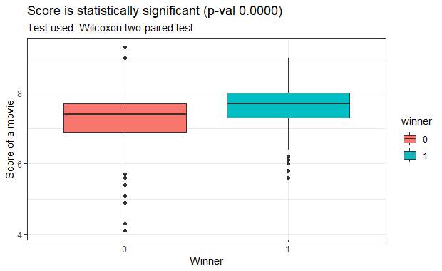
Movie score by result
04

Slide 16
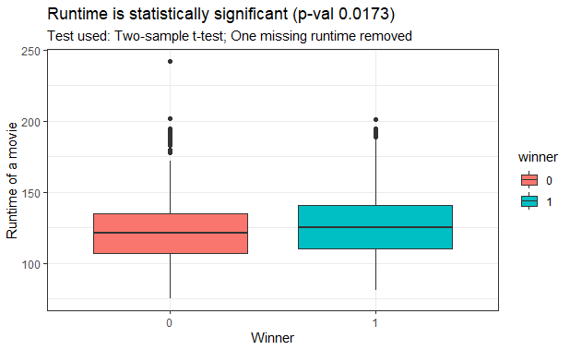
Movie runtime by result
04

Slide 17
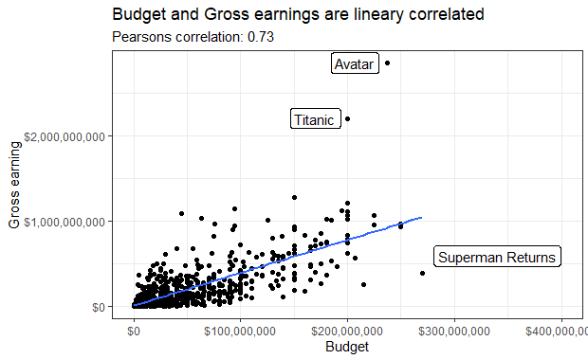
Budget and gross earnings
04

Slide 18




Four main conclusions
Country
Directors
United states
James Cameron
Movie company
Budget vs. Gross
Warner Bros
High positive correlation

Slide 19
Thanks!
Please keep this slide for attribution

